Slide 1
HR INSIGHTS USING SQL

Slide 2
Contents of the project
Objective of the project.
Tools used in this project.
KPI Requirements
SQL Code Along with the output.

Slide 3
Objective of the project
The Objective of this project is to gain insightful data from the various employees department which would aid the management to make important decisions.
The project aims to identify patterns and insights related to employee attrition, performance, satisfaction, and compensation, while leveraging advanced SQL techniques such as window functions, aggregate functions, and subqueries.
The ultimate goal is to provide actionable insights that can improve HR strategies, optimize workforce management, and enhance overall organizational effectiveness.

Slide 4
Tools used in the project
MySQL
Data grip
Excel

Slide 5
KPI Requirements
Employee Attrition Rate
Average Employee Tenure
Employee Satisfaction Scores
Average Monthly Income
Diversity Index
Work-Life Balance Index
Promotion Rate

Slide 6

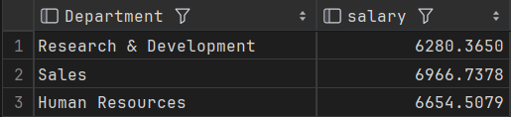
What is the average age of employees in each department?

Slide 7

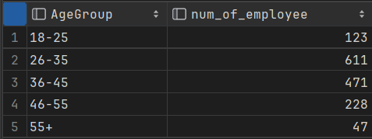
How many employees are in each Age Group?

Slide 8
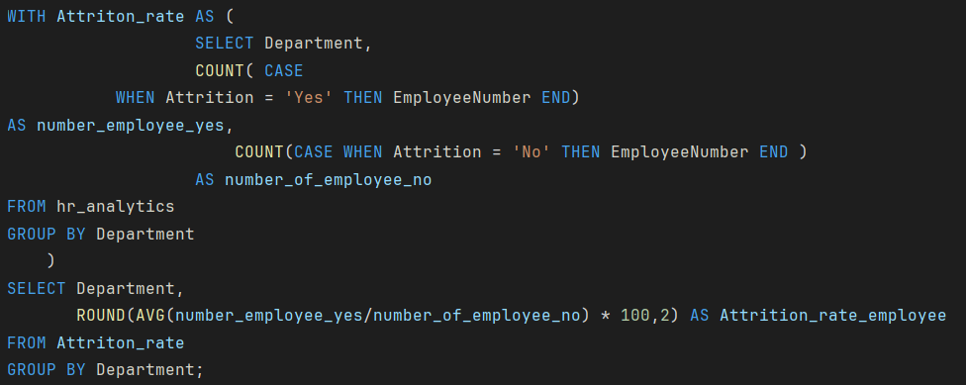
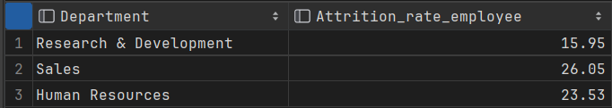
What is the attrition rate by department?

Slide 9

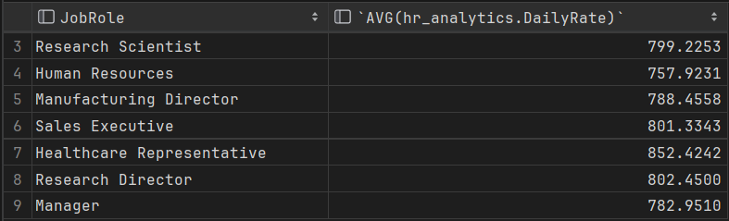
What is the average Daily Rate by Job Level?

Slide 10

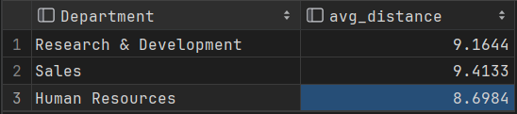
How does the average Distance From Home vary across different departments?

Slide 11

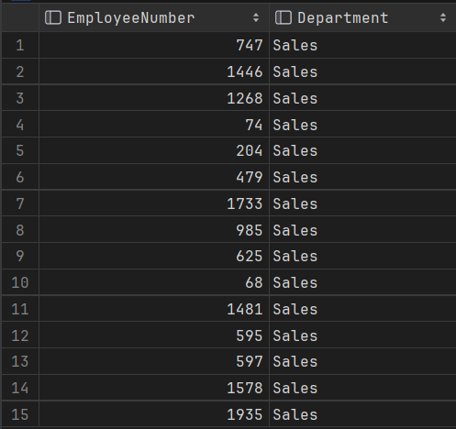
What is the highest level of Education achieved by employees in the Sales department?

Slide 12
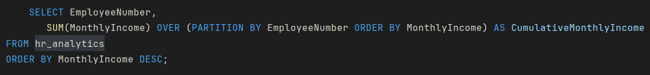
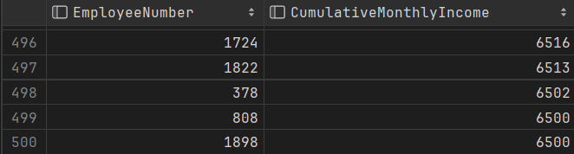
Calculate the cumulative Monthly Income for each department.

Slide 13
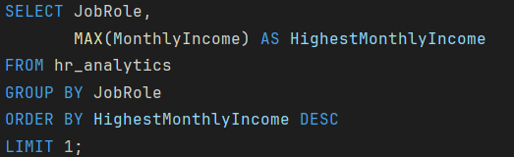

Which Job Role has the highest Monthly Income?

Slide 14
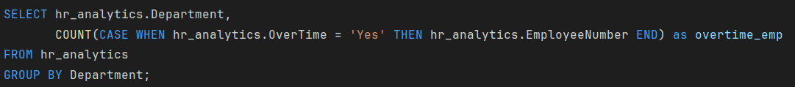
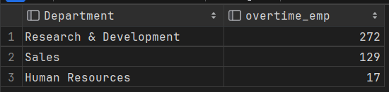
Calculate the average Salary Slab of employees by department over time.

Slide 15
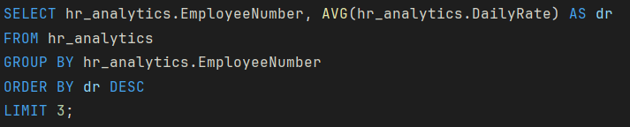
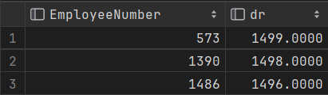
What is the top 3 highest Daily Rate across all employees?

Slide 16
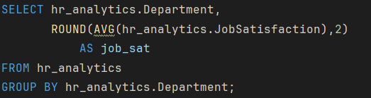
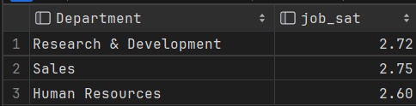
Find the average Job Satisfaction for each department.

Slide 17


Calculate the difference between the highest and lowest Monthly Income within each department.

Slide 18
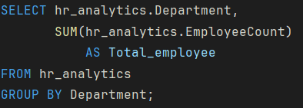
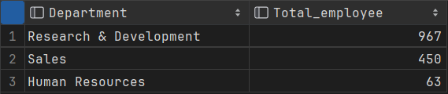
What is the total number of employees in each department?

Slide 19
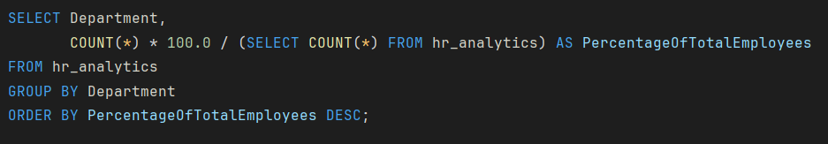
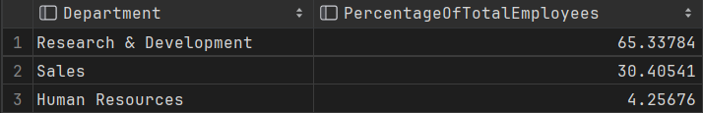
Calculate the percentage of total employees working in each department.

Slide 20
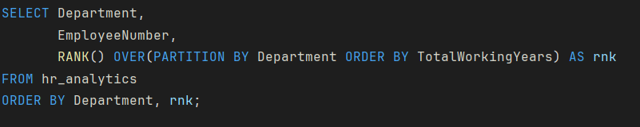
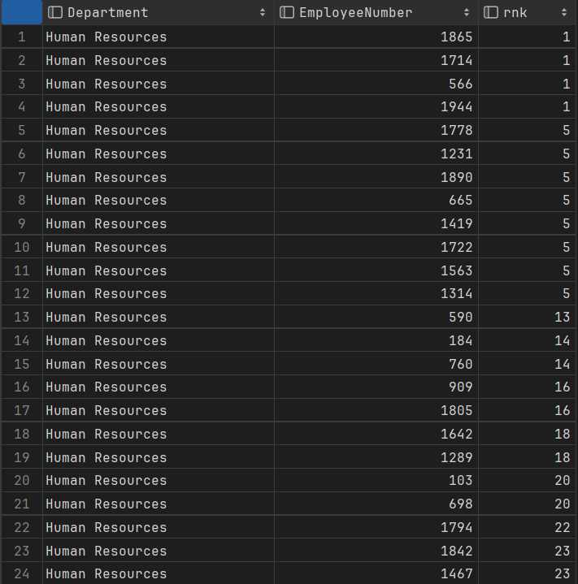
Rank employees by their Total Working Years within their department.

Slide 21
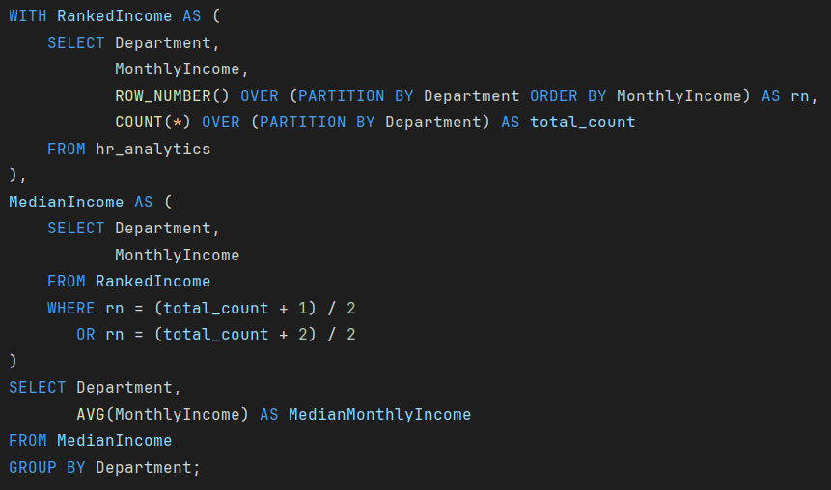
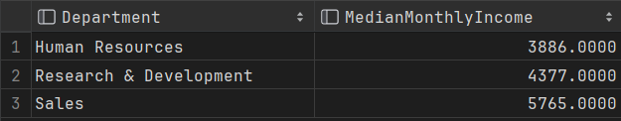
What is the median MonthlyIncome in each department?

